Slide 1

NAME: DHATTIWALA MOHAMMDPARVEZ MEHBOOBILAHI
Enrolment No.: 202218100031
Title: Hotel Parvez Food Menu Website

Slide 2
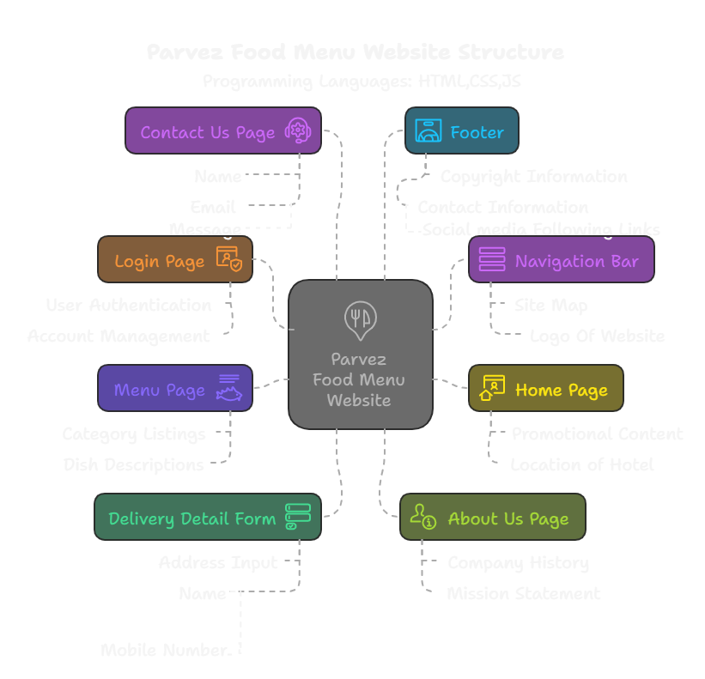

Slide 3
Problem Summary
No HTTPS (SSl/TLS Encryption)
Weak CAPTCHA
Easy For bots to bypass
Direct Local File Paths in image
No Input validation on forms
Files can’t load online+ possible leakage of file system structure.
Risk of SQL injection,XSS attacks
No Session Management
No protection after login (e.g.session expiration,cookies)
Data (login,orders) can be intercepted

Slide 4
How to fix these problems
Problem | Solution
No HTTPS | Add SSL certificate (Let's Encrypt)
Weak CAPTCHA | Use Google reCAPTCHA v3
Local File Paths in Images | Upload images to server and link using correct relative paths
No Input Validation | Validate + Sanitize all user inputs
No Session Management | Implement Secure login sessions, logout, timeout

Slide 5
Tools to Use
SSL/TLS Encryption
Let’s Encrypt/Cloudflare SSL
CAPTCHA Protection
Google reCAPTCHA
Website Vulnerability Testing
OWASP ZAP, Burp Suite
Secure Coding Practice
GitHub Code Scanning, SonarQube

Slide 6
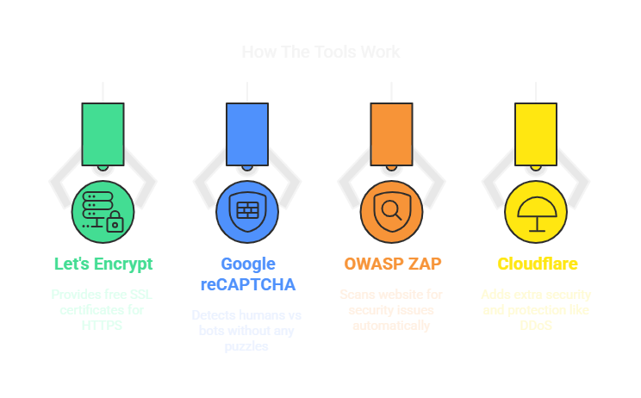

Slide 7
Security Tips
Use Strong Password Policy
Limit Login Attempts
Keep Software Updated
Use Firewalls
Backup Regularly
Minimum 8-12 Character, mix letters, numbers, symbols
Protect against brute force attacks
Regularly Updates plugins, libraries
Protect your servers from common attacks.
Always Have a Backup in case of attack or crash

Slide 8
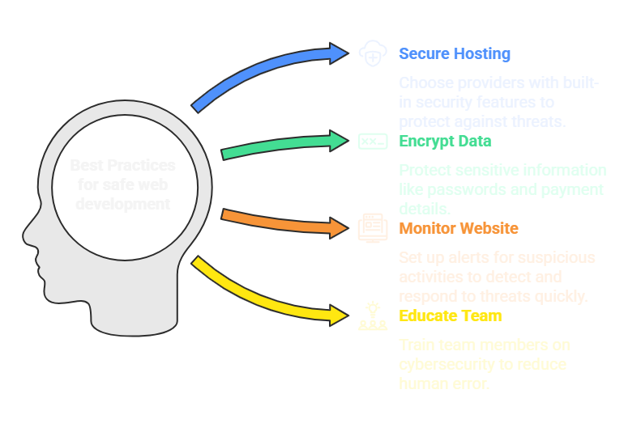

Slide 9
Conclusion
Website security is not optional – it is essential
Protecting user data builds trust and reputation.
Ignoring security issues can lead to data theft, website hacking, and financial loss.
Basic security steps like HTTPS, input validation, CSRF protection, and CAPTCHA can prevent most common attacks.
A secure website = safe customers + successful business.

Slide 10
THANK YOU

